Slide 1
Decision Trees

Slide 2
Decision Trees
Decision tree learning uses a decision tree as a predictive model to go from observations about an item (represented in the branches) to conclusions about the item's target value (represented in the leaves).
It is one of the predictive modelling approaches used in statistics, data mining and machine learning.
Tree models where the target variable can take a discrete set of values are called classification trees; in these tree structures, leaves represent class labels and branches represent conjunctions of features that lead to those class labels.
Decision trees where the target variable can take continuous values (typically real numbers) are called regression trees.

Slide 3
Decision Trees
Decision trees used in machine learning are of two main types:
Classification tree analysis is when the predicted outcome is the class (discrete) to which the data belongs.
Regression tree analysis is when the predicted outcome can be considered a real number (e.g. the price of a house, or a patient's length of stay in a hospital).

Slide 4
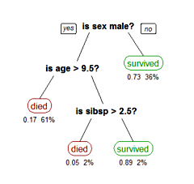
Decision Trees
A tree showing survival of passengers on the Titanic ("sibsp" is the number of spouses or siblings aboard). The figures under the leaves show the probability of survival and the percentage of observations in the leaf. Summarizing:
Your chances of survival were good if you were
a female or
a male younger than 9.5 years with less than 2.5 siblings.

Slide 5
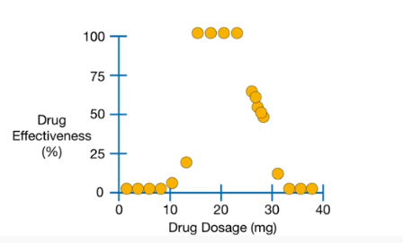
Decision Trees

Slide 6
Decision Trees-Advantages:
Simple to understand and interpret.
Able to handle both numerical and categorical data.
Other techniques are usually specialized in analyzing datasets that have only one type of variable. (For example, relation rules can be used only with nominal variables while neural networks can be used only with numerical variables or categoricals converted to 0-1 values.)
Requires little data preparation. Other techniques often require data normalization. Since trees can handle qualitative predictors, there is no need to create dummy variables.
Uses a white box model. If a given situation is observable in a model the explanation for the condition is easily explained by boolean logic. Possible to validate a model using statistical tests.

Slide 7
Decision Trees-Advantages:
Non-statistical approach that makes no assumptions of the training data or prediction residuals;
e.g., no distributional, independence, or constant variance assumptions
Performs well with large datasets.
Mirrors human decision making more closely than other approaches.
Robust against co-linearity, particularly boosting.
In built feature selection. Additional irrelevant feature will be less used so that they can be removed on subsequent runs.
Decision trees can approximate any Boolean function
eg: XOR

Slide 8
Decision Trees- Limitations
Trees can be very non-robust. A small change in the training data can result in a large change in the tree and consequently the final predictions.
Decision-tree learners can create over-complex trees that do not generalize well from the training data (overfitting).
For data including categorical variables with different numbers of levels, information gain in decision trees is biased in favor of attributes with more levels.

